Slide 1







Hybrid Gate-Pulse Model for Variational Quantum Algorithms
Zhiding Liang, Zhixin Song, Jinglei Cheng, Zichang He, Ji Liu. Hanrui Wang, Ruiyang Qin, Yiru Wang, Song Han, Xuehai Qian, Yiyu Shi
University of Notre Dame, Georgia Institute of Technology, Purdue University, University of California, Santa Barbara, Argonne National Laboratory, Massachusetts Institute of Technology

Slide 2

Outline
Motivation
Quantum Control and QAOA
Quantum Pulse Control
QAOA
Hybrid Gate-Pulse Model
Pulse-level Knowledge for Problem-Agnostic Layer
Gate-level Knowledge for Problem-Dependent Layer
General Optimization Techniques
Evaluation and Discussion

Slide 3
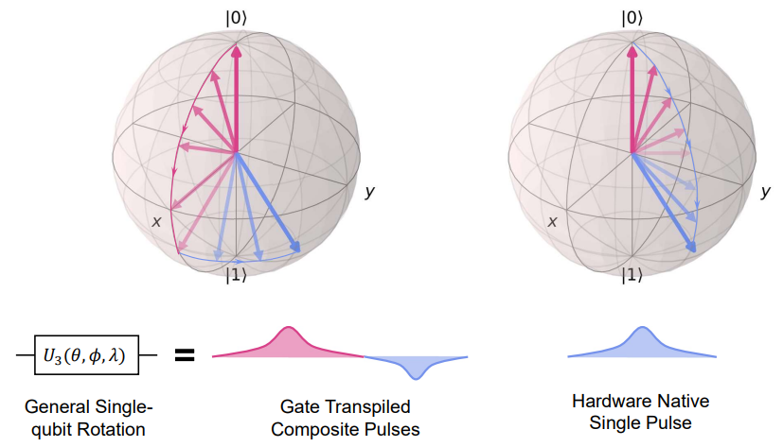
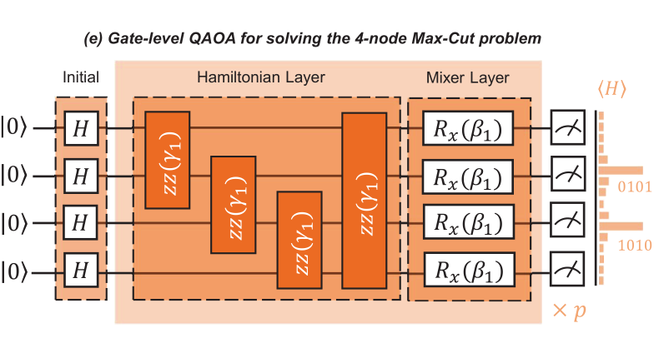
Motivation
Redundancy existing at gate-level compilation progress, pulse-level could gain the natural benefits on latency.
Gate-level has lots of existing algorithmic design knowledge, e.g. the Hamiltonian layer of QAOA is encoded from theoretical level, whereas, pulse-level is currently like a black box optimization.

Slide 4
Outline
Motivation
Quantum Control and QAOA
Quantum Pulse Control
QAOA
Hybrid Gate-Pulse Model
Pulse-level Knowledge for Problem-Agnostic Layer
Gate-level Knowledge for Problem-Dependent Layer
General Optimization Techniques
Evaluation and Discussion

Slide 5
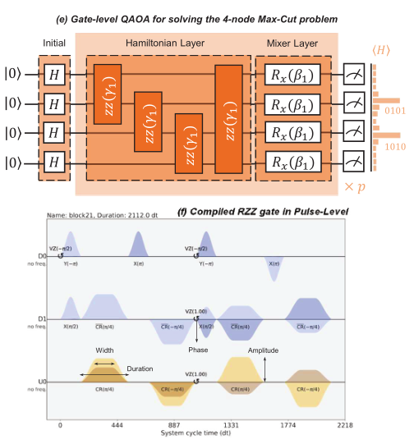
Quantum Control and QAOA
QAOA and the Max-Cut Problem: QAOA uses a series of parametrized quantum gates for unitary transformation. Max-Cut problem is need to find a partition of a graph's vertices that maximizes the number of edges between the sets.
QAOA Ansatz and Adiabatic Theorem: QAOA's ansatz involves an alternating structure inspired by the Quantum Adiabatic Theorem. A Hamiltonian encodes the Max-Cut problem, and the ground state is the optimal solution.
Quantum Pulse Control: For superconducting quantum computers, the pulse-level is the lowest layer of the workflow. A pulse is a sequence of analog control signals applied to different qubits. Different channels in IBM's quantum devices serve various roles, from associating with qubits to storing measured data.

Slide 6
Outline
Motivation
Quantum Control and QAOA
Quantum Pulse Control
QAOA
Hybrid Gate-Pulse Model
Pulse-level Knowledge for Problem-Agnostic Layer
Gate-level Knowledge for Problem-Dependent Layer
General Optimization Techniques
Evaluation and Discussion

Slide 7
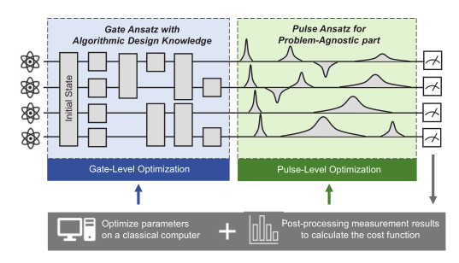
Hybrid Gate-Pulse Model
Gate-level ansatz with algorithmic design knowledge
Pulse-level ansatz for problem-agnostic part
The algorithmic knowledge of gate level is used to ensure the fidelity of the circuit.
In the problem-agnostic part, pulse level is used for more flexible control to obtain further accuracy improvement.

Slide 8
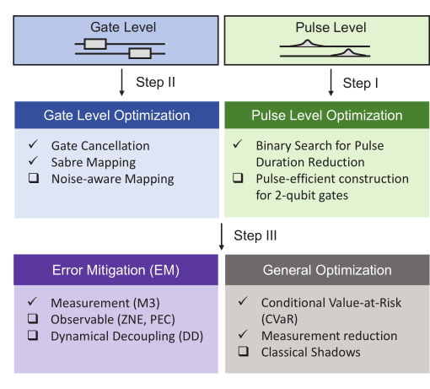
Hybrid Gate-Pulse Model
Pulse-level Optimization Techniques
Parametric Pulse Definition: We construct a hybrid gate-pulse model for our project. Within this model, we define a parametric pulse. The pulse duration is initially set to a value multiple of 16 dt, based on the constraints of the qiskit pulse for Gaussian waveforms. And the frequency also been carefully tunned.
Binary Search Algorithm for Pulse Duration: We use a binary search algorithm to efficiently find the appropriate pulse duration. This is done by iteratively halving the search space until the minimum required pulse duration is found.
Performance Preservation: By using our binary search algorithm and the principles of QOC, we ensure that our model remains effective and efficient.

Slide 9
Hybrid Gate-Pulse Model
Why the gate-level knowledge plays important role in the proposed model?
Pulse-Level Optimization: Direct optimization creates an unknown final state, requiring state tomography. Preserving the structure of certain algorithms at the pulse level is challenging and needs long-term work.
Calibration in Gate-to-Pulse Transformation: Transforming from gate-level to pulse can disrupt careful calibration. Controlling pulse parameters introduces variance due to noise, compromising precise control.

Slide 10
Hybrid Gate-Pulse Model
Gate-level Optimization Techniques
Sabre Mapping & Commutative Cancellation: We use Sabre mapping for better qubit routing and commutative cancellation to remove redundant gates, enhancing our model's efficiency.
Selective Optimization Illustration: Although many gate-level optimizations are possible, we've chosen a few to demonstrate compatibility.

Slide 11
Hybrid Gate-Pulse Model
General Optimization Techniques
What we demonstrated in this project?
Matrix-Free Measurement Mitigation (M3): Postprocessing is applied to all shots returned from the backend, using calibration data to estimate probability distributions and confidence intervals.
Performance Optimization Protocol: We add methods to the protocol that perform a general performance optimization using the conditional risk value.
What can we try in the future?
Dynamic Decoupling

Slide 12
Outline
Motivation
Quantum Control and QAOA
Quantum Pulse Control
QAOA
Hybrid Gate-Pulse Model
Pulse-level Knowledge for Problem-Agnostic Layer
Gate-level Knowledge for Problem-Dependent Layer
General Optimization Techniques
Evaluation and Discussion

Slide 13
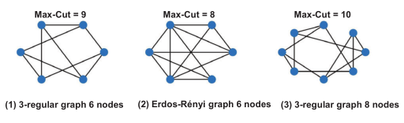
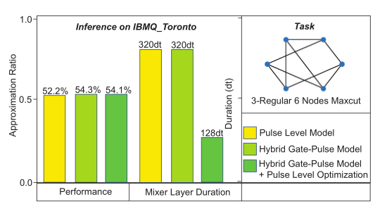
Evaluation and Discussion
Three different size Max-Cut problem evaluate on three different IBM real QCs.
Observation from Pulse-level Optimization:
60% duration shorter with tiny effect on performance.
2.1% advantage in terms of AR with x4 faster to reaching the convergence.

Slide 14
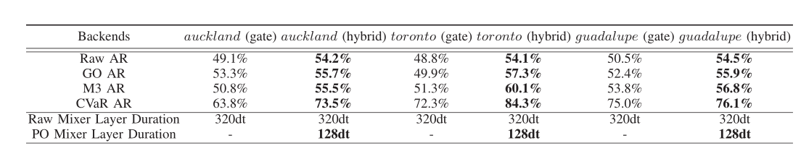
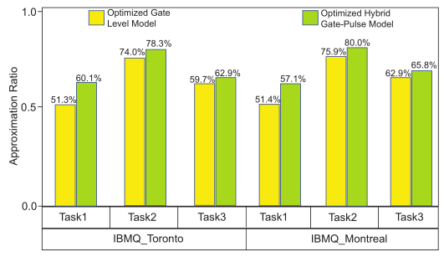
Evaluation and Discussion
Both gate-level optimization methods and measurement error mitigation are compatible with our proposed model, achieving 3.2% and 2.8% improvement towards AR.
Raw Hybrid Model Advantage: The raw hybrid gate-pulse model shows up to 5.3% better than gate-model.
Gate-Level Optimization Benefit: With gate-level optimization methods, our model's approximation ratio shows up to 7.4% over gate-model.
M3 Implementation Effect: Proposed model achieves up to 60.1% approximation ratio, 8.8% higher than the gate-level model.

Slide 15
Thanks for Listening Q&A

